Slide 1
Semantic Analysis of
Text Implemented in Pyro
Shah Rahil Kirankumar - 2020B2A71677G
Shivam Thakur - 2020B4A71581G
B Sarvesh - 2020B5A71839G

Slide 2
Overview
Aim is to do Semantic Analysis of Text Implemented in
Pyro
Reliability - Reduces possibility of data type mismatches because we are using inference algorithms.
Ease of use - Only the model and the guide specification is needed to run the optimizer (the objective function does not need to be specified as in the PyTorch implementation).

Slide 3
Why Pyro?
Pyro is a probabilistic programming framework by Uber AI. It’s built on PyTorch and uses Python for defining probabilistic relationships. It supports a wide range of models, capturing uncertainty and dependencies in data, making it a powerful tool for researchers and data scientists.

Slide 4
Why Pytorch for comparison?
PyTorch is a popular deep learning framework, while Pyro, built on PyTorch, is a probabilistic programming language (PPL). This combination allows for the expression of complex probabilistic relationships and model uncertainty in data.

Slide 5
Code Implementation
Following were used :-
Class Model: Utilizes Pyro for implementing the neural network, showcasing the power of probabilistic programming.
Class Neural Network: A parallel implementation using PyTorch, demonstrating the strength of a leading deep learning framework.
These classes exemplify the integration of PyTorch and Pyro, merging deep learning and probabilistic modeling for sophisticated data analysis.

Slide 6
Database
Series of sentences divided into two “questions” each question having 199 entries
We get a quora_data_with_clusters file that tells us whether the question entries belong to the same cluster or not
A test_predictions file that has a predicted_is_duplicate entry which compares same id entries of each question
A train file that has a is_duplicate entry which compares entries of each question ( they don't have to have the same id)

Slide 7
Outputs

Slide 8
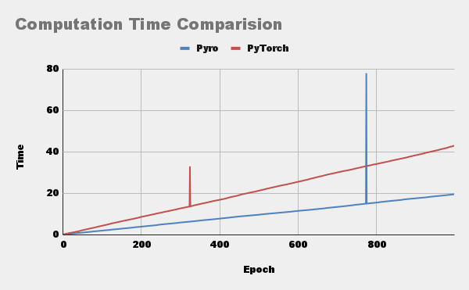

Slide 9
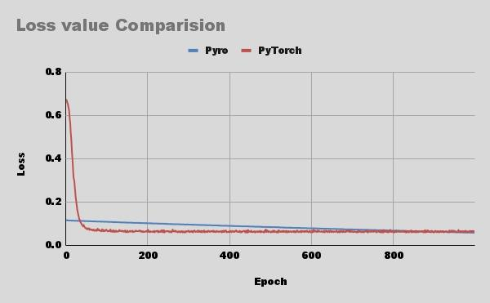

Slide 10
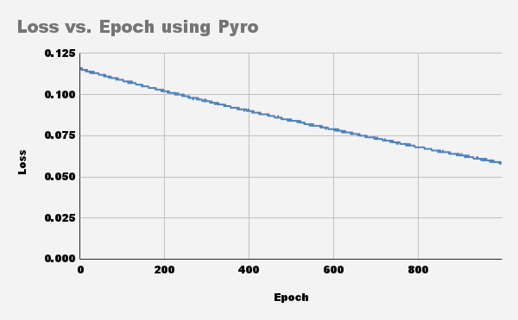
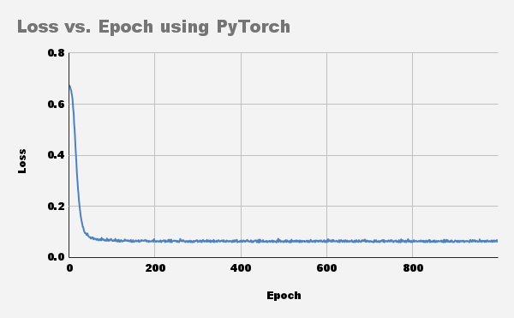

Slide 11
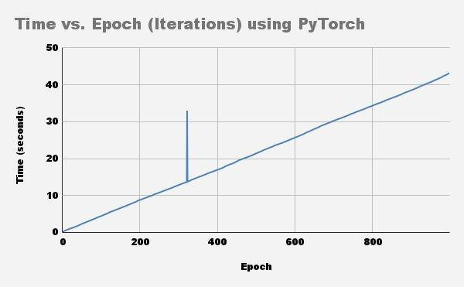
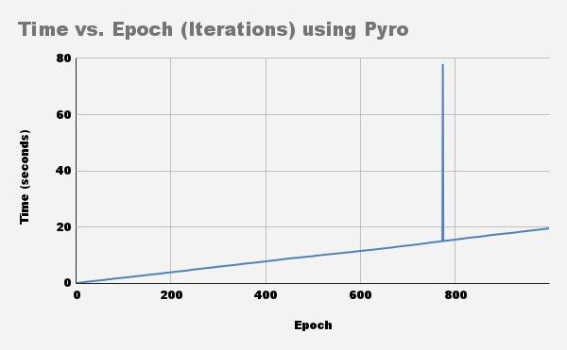

Slide 12
THANK YOU

